Slide 1
Introduction to data Science
Final Project
Sagi Dahari

Slide 2


Research question
Can we predict the price of prestige watches , using the data from the website : chrono24.com ?

Slide 3
Table Of Contents
Scraping / Crawling
EDA – Exploratory Data Analysis
Summary
1
3
5
2
4
Data Cleaning and Handling
Supervised Learning

Slide 4
Scraping \ Crawling
1

Slide 5
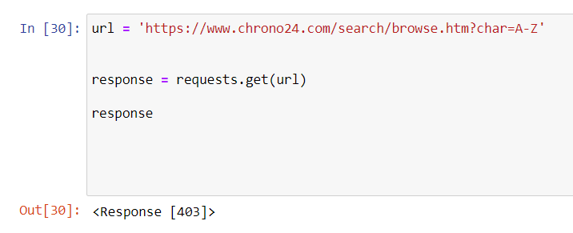
Scraping\Crawling
At first, I tried to scrape the data using the requests library, but I got a ‘403 Response’, which means my access to the website was denied.
I decided using Selenium for the crawling process, which allowed me a better navigation through the website , and a more convenient crawling process.
The whole process took 2 days and in total I have acquired 289,120 pieces of data.

Slide 6
Data Cleaning and Handling
2

Slide 7
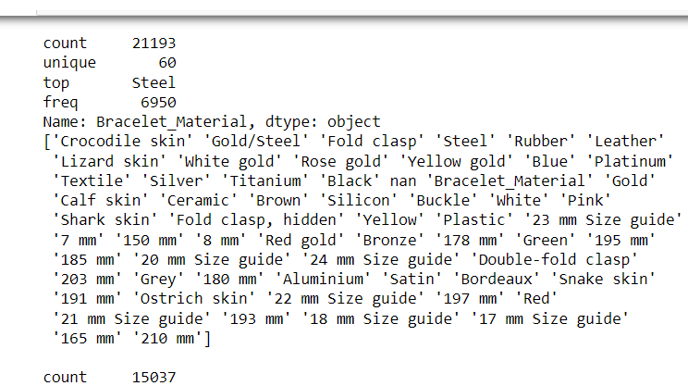
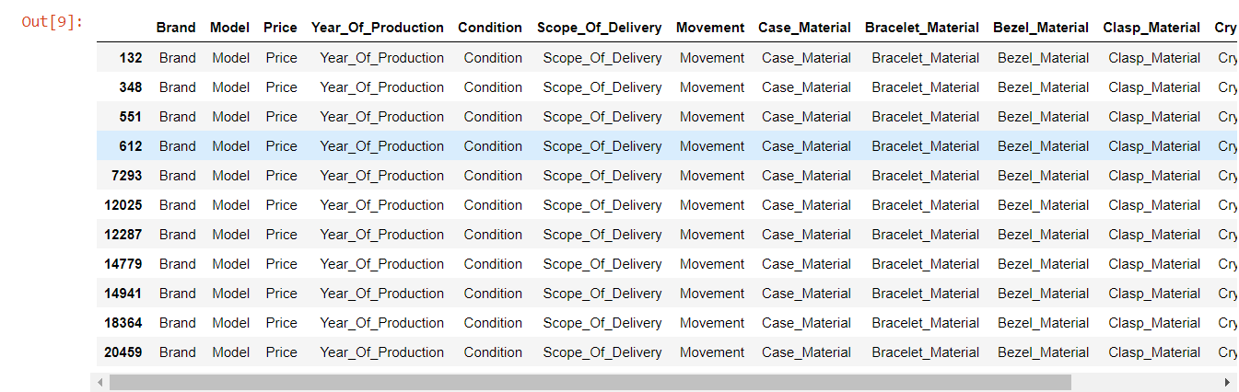
Data Cleaning and Handling
In this part I’ve started with :
- dropping any rows which had more than 7 null values.
- duplicated rows removal.
After a brief exploration of the dataframe I noticed that I’ve acquired a lot of corrupt data (values that are not matching the variable type)
I’ve realized that there are too much of these corrupt values so I decided to get rid of them as well.

Slide 8
Also,
I removed all of the brands that has less than 50 instances, and models that has less than 8 instances.
I’ve converted each column to it’s right data type, and removed any unwanted characters in some columns.
At last, after I realized that I don’t have enough numeric data variables in order to use a linear regression model, I’ve decided to create a new column of price bins, in order to try to predict the “Price Range” of each watch, using classification models.
The whole process left me with 147,849 pieces of data

Slide 9
EDA – Exploratory Data Analysis
3

Slide 10
EDA – Exploratory Data Analysis
In this part I’ve tried to uncover correlations between the columns.
At first, I’ve displayed the data in simple plots in order to learn more about it.
I will display some of my plots in the next slide.

Slide 11
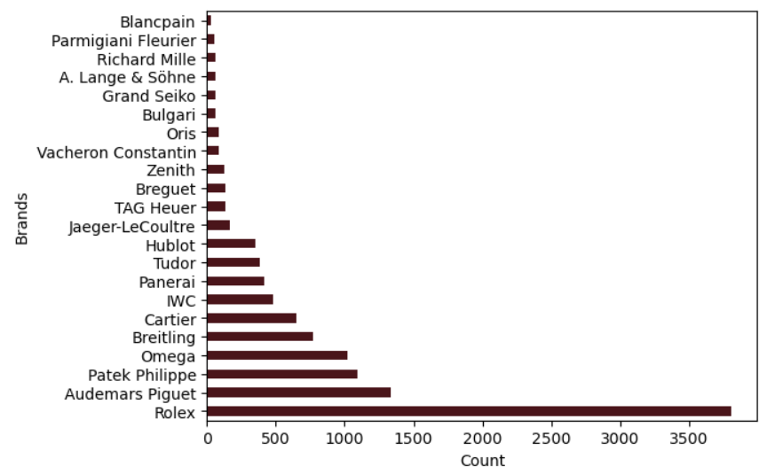
Brands count

Slide 12
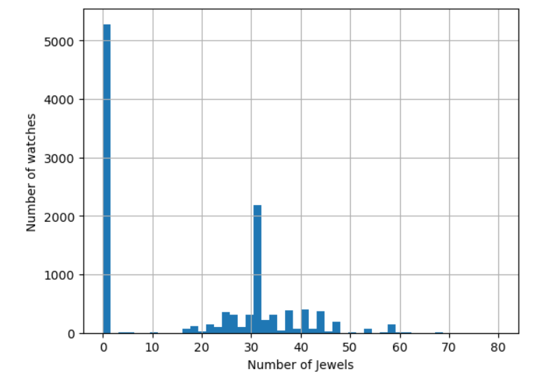
Number of jewels distribution

Slide 13
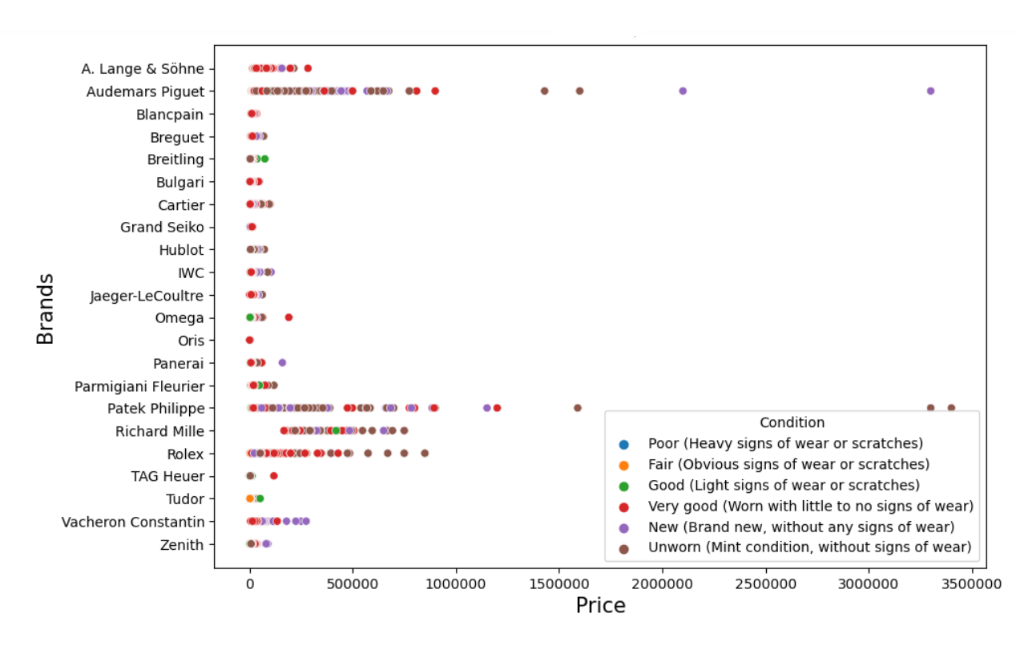
Brands Vs. Price

Slide 14
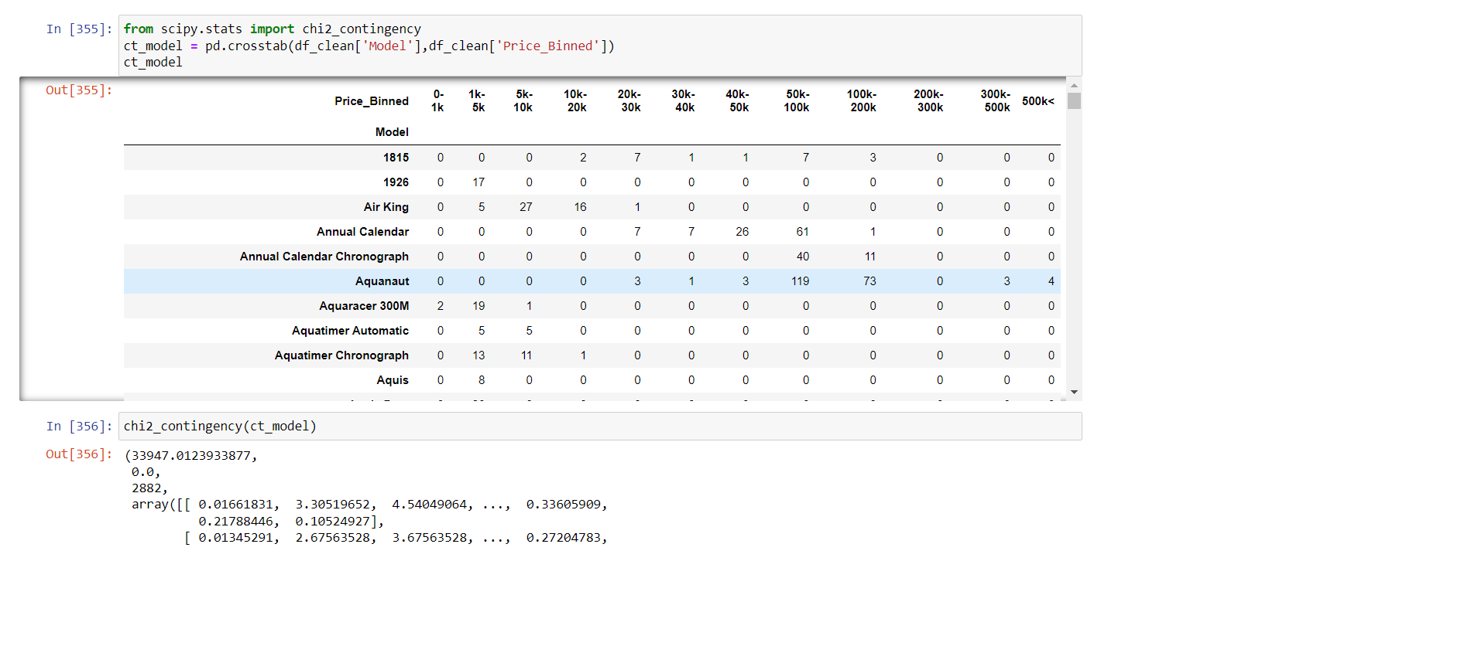
After looking into some of the plots I couldn't find a direct correlation between the columns so I've decided to use the chi squared test which provided me with good p results of 0.0.

Slide 15
EDA Conclusion
The EDA part didn’t provide me with a lot of correlations but the chi squared test did point out that there could be a correlation between the categorical columns which are : Case Material, Bracelet Material, Bezel Material, Clasp Material, Brand, Model, etc…

Slide 16
Supervised Learning
4

Slide 17
Supervised Learning
In this part I've tried 3 classification algorithms : KNN, decision tree, and Naïve Bayes.
At first I split my data into train and test dataframes, in order to train my classification models.
After running the models, my test results weren’t very high, so, I tried to manipulate the train data, in order to get better results, but to no avail.

Slide 18
Summary
In this project I learned a lot about acquiring data, handling it, and using different machine learning tools and algorithms.
I also learned that you can not predict the price of watches, using the exact variables that I used , but I will certainly try it with different variables in the future.
In general, the price of watches is determined by many other factors, such as: prestige, design, exclusive mechanism and more.

